Slide 1
Key Logger And Security
CAPSTONE PROJECT
Presented By:
1. AARTHI T – JKKNCET – B.Tech-IT

Slide 2
OUTLINE
Problem Statement
Proposed System/Solution
System Development Approach
Algorithm & Deployment
Result
Conclusion
Future Scope
References

Slide 3
Problem Statement
In today's digital age, where cybersecurity threats loom large, one of the significant concerns is the proliferation of keyloggers, stealthy software tools designed to monitor and record keystrokes on a user's computer without their knowledge. Keyloggers pose a severe threat to individuals and organizations as they can capture sensitive information such as passwords, credit card details, and other personal data, leading to identity theft, financial loss, and privacy breaches.

Slide 4
Proposed Solution
keyloggers are indeed a significant concern in today's digital age. To protect yourself and your organization from keyloggers, here are some solutions and best practices to consider:
Use Antivirus and Anti-Malware Software: Install a reputable antivirus and anti-malware solution on your computer systems. Keep the software up to date and regularly scan your system for any potential threats, including keyloggers.

Slide 5
Keep Your Operating System and Software Updated: Regularly update your operating system, web browsers, and other software applications. These updates often include security patches that address known vulnerabilities that keyloggers can exploit.
Be Cautious of Phishing Attempts: Many keyloggers are delivered through phishing emails or malicious links. Be cautious when clicking on links or downloading attachments from unknown or suspicious sources. Avoid providing sensitive information through email or forms unless you are certain of the recipient's legitimacy.

Slide 6
Use Two-Factor Authentication (2FA): Enable two-factor authentication whenever possible. 2FA adds an extra layer of security by requiring an additional verification step, such as a temporary code sent to your smartphone, in addition to your password.
Employ a Virtual Private Network (VPN): Use a VPN when connecting to the internet, especially when using public Wi-Fi networks. A VPN encrypts your internet connection, making it more difficult for keyloggers to intercept your data.

Slide 7
Regularly Monitor Your Financial Accounts: Keep a close eye on your financial accounts and credit reports for any suspicious activity. Report any unauthorized transactions immediately.
Practice Strong Password Hygiene: Use strong, unique passwords for each online account. Avoid using easily guessable information such as birthdays or names. Consider using a password manager to generate and store complex passwords securely.

Slide 8
Exercise Caution with Third-Party Downloads: Be cautious when downloading software or files from the internet. Stick to trusted sources and reputable websites to minimize the risk of downloading infected files that may contain keyloggers.
Educate Yourself and Your Organization: Stay informed about the latest cybersecurity threats and educate yourself and your organization on best practices for staying safe online. Training programs and workshops can help raise awareness and promote safe online practices.
Use Keystroke Encryption Tools: Consider using keystroke encryption tools that encrypt your keystrokes at the keyboard level, making it difficult for keyloggers to capture your sensitive information.

Slide 9
System Approach
The "System Approach" section outlines the overall strategy and methodology for developing and implementing the rental bike prediction system. Here's a suggested structure for this section:
Secure Network Infrastructure
Endpoint Protection
Privilege Management
Centralized Logging and Monitoring
Patch Management

Slide 10
Algorithm & Deployment
Algorithm
Install and update reliable antivirus and anti-malware software on all computers.
Regularly update the operating system and software applications to patch security vulnerabilities.
Enable two-factor authentication (2FA) for added security.
Use a virtual private network (VPN) when connecting to the internet, especially on public Wi-Fi networks.
Be cautious of phishing attempts and avoid clicking on suspicious links or downloading attachments from unknown sources.
Practice strong password hygiene and consider using a password manager.
Monitor financial accounts and credit reports for any unauthorized activity.
Educate yourself and your organization on cybersecurity best practices.
Consider using keystroke encryption tools to protect sensitive information.

Slide 11
Deployment Process:
Evaluate the existing network infrastructure and security measures in place.
Identify any gaps or vulnerabilities that could expose systems to keyloggers.
Select and procure appropriate security software solutions, such as antivirus, anti-malware, and endpoint protection tools.
Configure and deploy the selected security software on all computers and endpoints within the organization.
Establish a patch management process to ensure regular updates of the operating systems and software applications.
Implement two-factor authentication and VPN solutions for secure remote access.
Conduct employee training and awareness programs on cybersecurity best practices.
Monitor systems for any suspicious activities or signs of keylogger incidents.
Establish an incident response plan to handle keylogger incidents, including isolation, analysis, and mitigation steps.
Continuously monitor and improve the security measures, conduct periodic audits, and stay updated with the latest security practices.

Slide 12

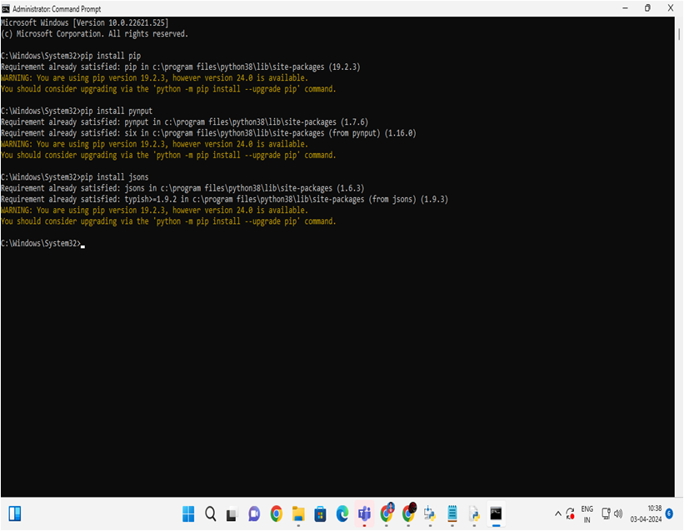
Program & deploy

Slide 13


RESULT

Slide 14
Result
Implementing robust antivirus/anti-malware software, regular updates, user awareness training, two-factor authentication, VPN usage, and monitoring systems can significantly reduce the risk of keyloggers and enhance overall cybersecurity.

Slide 15
Conclusion
Summarize by implementing a comprehensive approach including robust security measures, user awareness training, and proactive monitoring, the risk of keyloggers compromising systems and sensitive information can be significantly reduced, enhancing overall cybersecurity.

Slide 16
Future scope
Advancements in machine learning and artificial intelligence can be leveraged to develop more sophisticated detection algorithms capable of identifying and mitigating emerging keylogger variants, while technologies like biometric authentication and secure hardware can provide additional layers of protection against keylogger attacks.

Slide 17
References
Implementing comprehensive anti-keylogging software and regularly updating security protocols can mitigate the threat of keyloggers effectively. Additionally, promoting user education and awareness about safe online practices can further enhance cybersecurity resilience..

Slide 18
THANK YOU

